Slide 1

Investigate Business Hotel using Data Visualization
Created by:
Muhammad Cikal Merdeka
Email : mcikalmerdeka@gmail.com
LinkedIn : linkedin.com/in/mcikalmerdeka
Github : github.com/mcikalmerdeka
Dedicated entry-level data scientist with analytical and experimental background of Physics. My graduation 2023, a pivotal year marked by significant advancements in artificial intelligence with the introduction of GPT-4 and other generative AI models, has fueled my curiosity and excitement to delve into the field of data. I have comprehensive grasp of data science methodology from business understanding to modelling process with proficiency in Python, SQL, Tableau, Power BI, Looker Studio and other tools related to data analytics workflow from several coursework and bootcamps.

Slide 2
Impact Analysis of Lead Time on Hotel Bookings Cancellation Rates
In the hotel business, customers are typically allowed to book hotels before their arrival dates. The time interval between booking and arrival varies, ranging from just a few days to several months in advance. In this section, an analysis will be conducted to determine whether the time interval between hotel booking and the customer's arrival date has an influence on the cancellation rate of hotel reservations.
For more details, you can view the Jupyter notebook here.

Slide 3
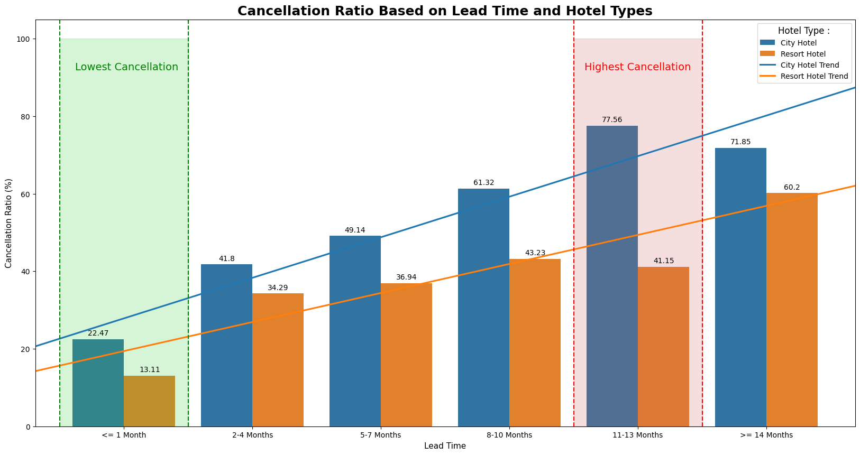
Impact Analysis of Lead Time on Hotel Bookings Cancellation Rates
Data Visualization :

Slide 4
Impact Analysis of Lead Time on Hotel Bookings Cancellation Rates
Data Interpretation and Business Recommendation :
In general, it can be said that both City Hotel and Resort Hotel types have a trend where the longer the lead time, the higher the risk that the customer will cancel their reservation.
Both hotel types have the lowest cancellation rate for lead times of <= 1 month, with City Hotel at 22.47% and Resort Hotel at 13.11%. This suggests that customers who book within a shorter time frame before their intended stay are more committed to their reservations and less likely to cancel.
Meanwhile, the highest cancellation rate is observed for lead times of 11-13 months, with City Hotel at 77.56% and Resort Hotel at 41.15%. This implies that customers who book significantly far in advance are more prone to canceling their reservations, indicating potential uncertainty or changes in plans over longer periods.

Slide 5
Impact Analysis of Lead Time on Hotel Bookings Cancellation Rates
Data Interpretation and Business Recommendation :
There are two business recommendation that we can apply based on these insights :
First we can implement dynamic pricing strategies based on lead time and historical cancellation patterns. Offer discounted rates or incentives for customers booking with shorter lead times to encourage immediate bookings and reduce cancellation risks. Conversely, for reservations with longer lead times, consider implementing stricter cancellation policies or requiring deposits to mitigate the potential revenue loss from cancellations.
Second we can develop targeted marketing campaigns to different types of customer with different lead time preferences. As for customers who frequently book with short lead time, we could promote exclusive offers and last-minute deals, emphasizing the benefits of spontaneous travel and instant savings. For customers with longer lead times, focus on highlighting the value of early booking advantages such as guaranteed availability and peace of mind.

